Slide 1


Food Waste: Not On My Watch

Slide 2
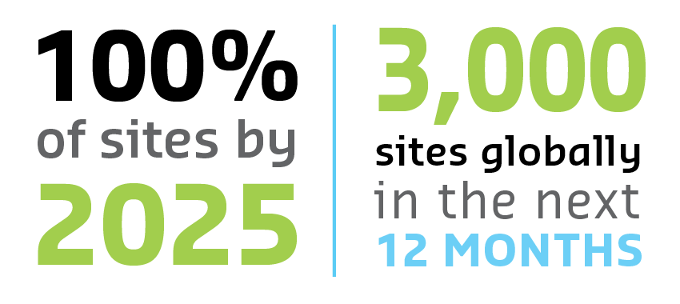

AT SODEXO, our mission is to improve the quality of life in the communities we serve all around the world. Given our corporate footprint and food purchasing reach, fighting the global crises of climate change and hunger must be part of that mission. Sodexo is championing these efforts by reducing the amount of food that goes to waste on our watch.
Sodexo began developing its food waste prevention program, WasteWatch powered by Leanpath (WWxLP), over 10 years ago, and Sodexo groups have been deploying it at sites across the globe. These pilot studies confirm that WWxLP works: On average, Sodexo locations reduced food waste by 50%.
SODEXO IS COMMITTED TO DEPLOYING WWxLP AT:

Slide 3
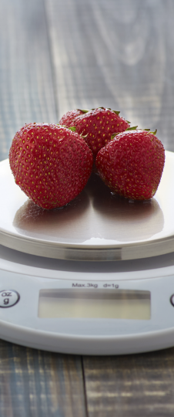

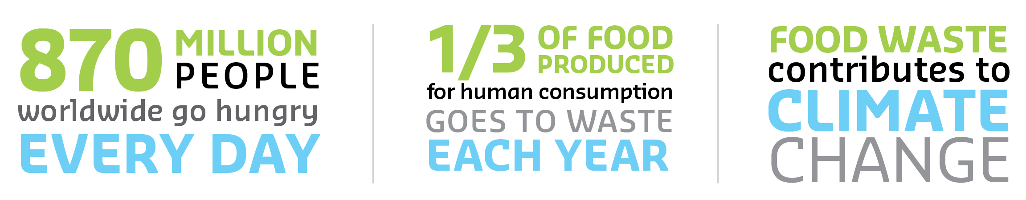

IT’S IMPORTANT
HUNGER AND CLIMATE CHANGE ARE A GLOBAL CRISIS
Did you know?
870 million people go hungry daily
1 in 7 Americans face food security
1/3 of the food produced globally goes to waste
Reducing food loss and waste is how we can ensure there is enough food for everyone.
Climate change is already causing damage to communities across the globe
Efficiencies across the supply chain reduce the emission of greenhouse gases.

Slide 4
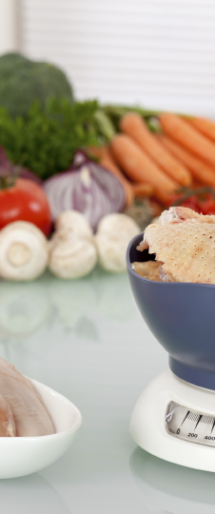

IT’S RIGHT
OUR GLOBAL PRESENCE REQUIRES GLOBAL LEADERSHIP
We serve:
100 million customers a day
At 13,000 sites
In 72 countries
WWxLP demonstrates our global leadership in pursuit of critical change.
Sodexo is committed to improving the well-being of those we serve by:
Fighting hunger and malnutrition
Reducing carbon emissions
Championing sustainability
Addressing wasted and surplus food anchors corporate responsibility into our daily operations.

Slide 5


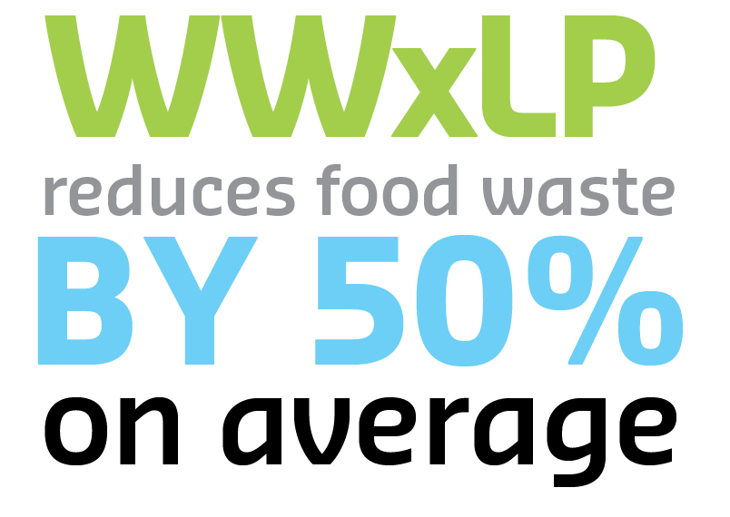
IT’S EFFECTIVE
WE MANAGE WHAT WE MEASURE
WWxLP:
Identifies efficiencies
Informs menus and operating procedures
Provides effortless tracking and progress reports
Automated tracking provides real-time information for in-time solutions.
Using Leanpath, Sodexo sites saw significant food waste reduction within three months
Most sites met the target reduction of 50 percent within a year.

Slide 6

We are signatories to Champions 12.3 (UN Sustainable Development Goal) and Champions 2030 (EPA), but our commitment surpasses these targets. We have committed to reducing food loss and waste 50 percent by 2025 rather than 2030. We do so by:
Collaborating with clients and suppliers across the value chain for superior results
Raising Awareness and Influencing the Behaviors of our customers and employees
Improving Processes and upgrading equipment and systems to drive operational efficiency
Measuring Our Impact to determine where we can improve
Sharing Our Expertise to reduce food waste throughout our communities

Slide 7
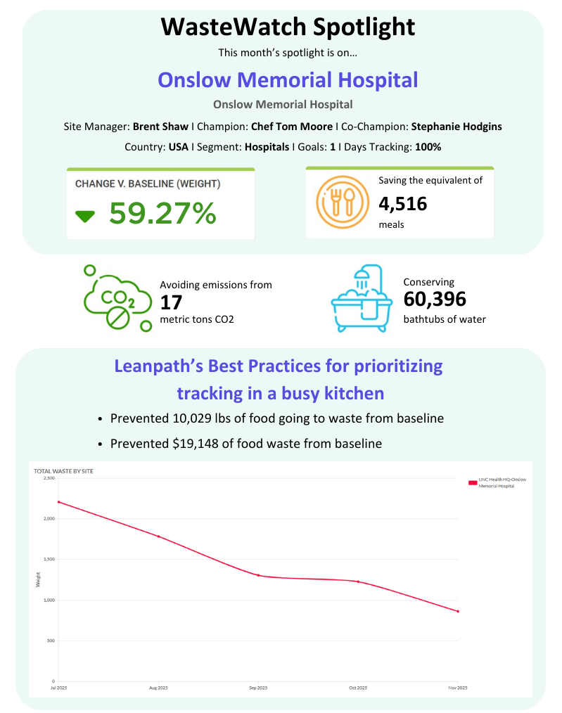

We welcome the opportunity to assist you with reducing food waste in your operations –
in pursuit of a better tomorrow!

